Slide 1
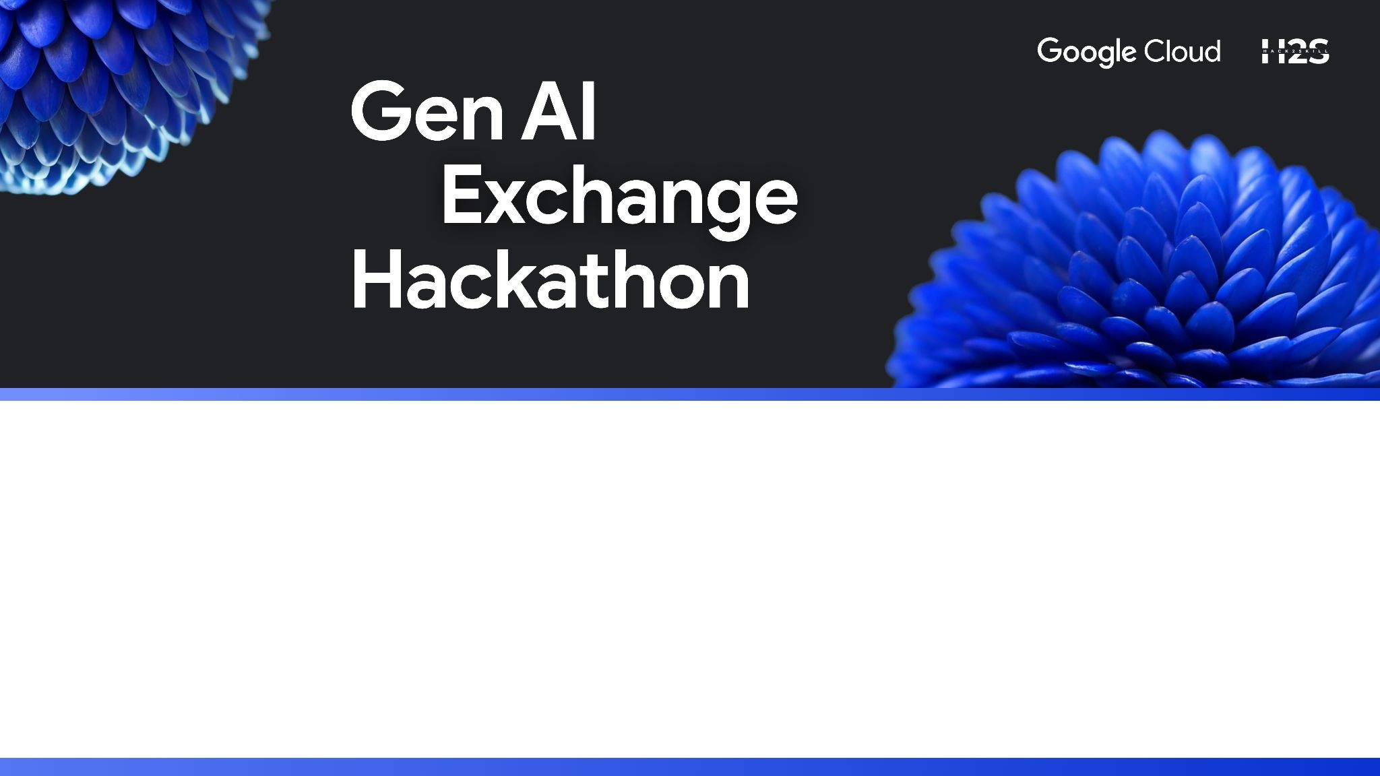
Team Name : Bug Slayer
Team Leader Name :Naresh Reddy Paluri
Problem Statement :Bridging the Digital and Physical Divide With Generative AI

Slide 2
Brief about the Prototype :
Definition: A prototype is an initial version of your Gen AI project that demonstrates the core idea, functionality, and user experience.
Purpose:
To showcase how your idea solves the given problem.
To let judges and mentors see the practical working of your AI solution.
To test the feasibility of your approach within the hackathon’s limited time.
Features:
Doesn’t need to be perfect or production-ready.
Should clearly highlight the innovation, usability, and impact.
Often includes a demo interface (like a chatbot, web app, or dashboard) + a backend model (AI/ML model, APIs, workflows).
Examples in Gen AI Hackathons:
A chatbot prototype using LLMs to answer domain-specific queries.
A text-to-image prototype generating designs for a given prompt.
A Gen AI-powered recommendation system for students or businesses.

Slide 3
Opportunity Prototype Breif :
1. How is it different from existing solutions?
Most existing platforms provide generic, one-size-fits-all outputs. Opportunity is different because it focuses on context-aware, personalized, and real-time insights, ensuring that users get solutions tailored to their specific needs rather than broad, unfocused results.
2. How will it solve the problem?
OpportunitQ takes raw or unstructured data, processes it using Generative AI techniques (reasoning, summarization, knowledge retrieval), and delivers clear, actionable
outputs. This reduces complexity, saves time, and enables users to make better and faster decisions.
3. Unique Selling Proposition (USP)
The USP of Opportunity lies in its ability to combine Generative AI intelligence with real-time adaptability and personalization, creating a solution that is faster, smarter, and more user-centric than existing alternatives.

Slide 4
List Of Features Offered by the Solution :
How is it different? Most tools give generic results → Opportunity delivers context-aware & personalized insights.
How will it solve the problem?
Input (raw data) → Gen AI Processing (reasoning + summarization) → Output (clear, actionable insights)
USP Real-time adaptability + personalization → A smarter, faster, user-centric solution.
Visual tip:
Add a simple flow arrow diagram in the middle.
Keep text minimal, let visuals explain.

Slide 5
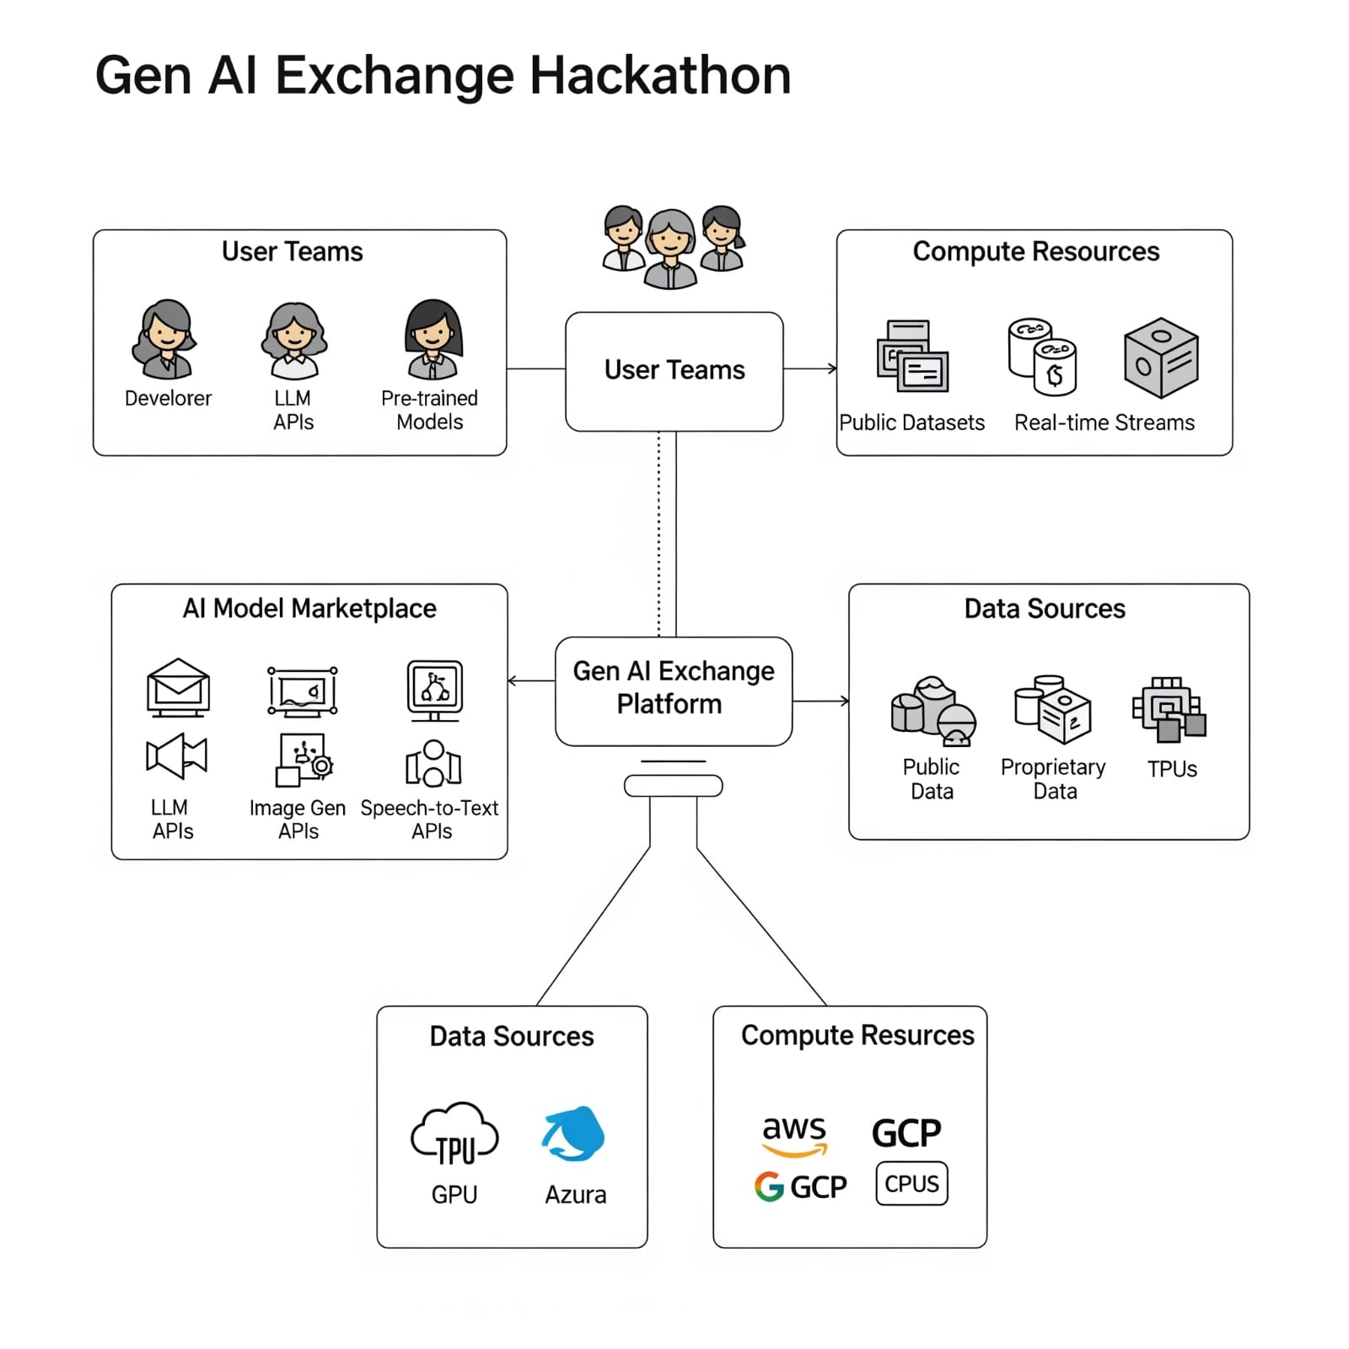
System Architecture :
.

Slide 6
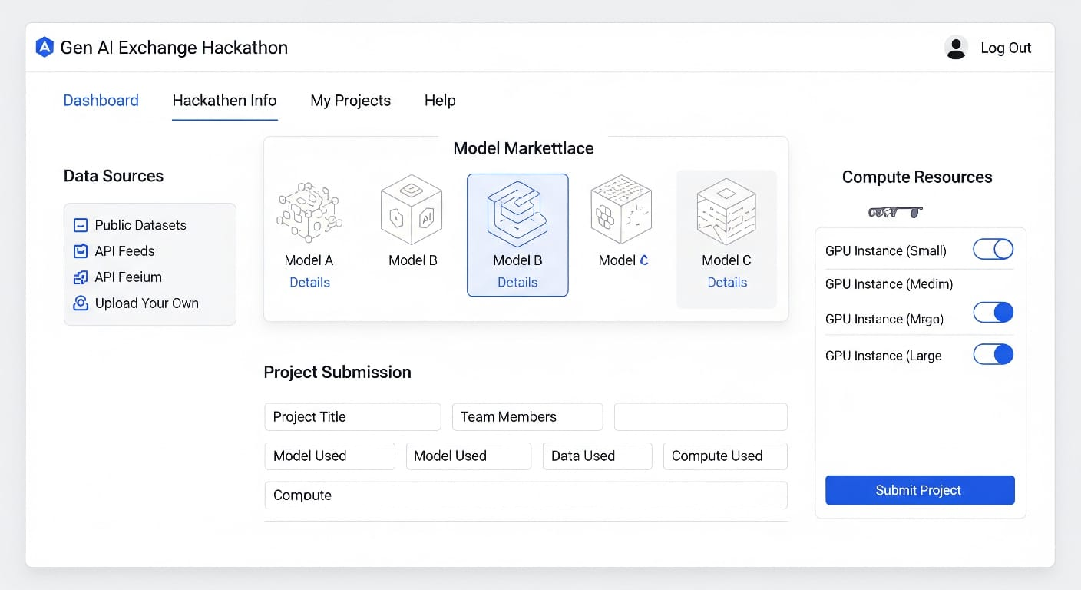
Mock Diagram :

Slide 7
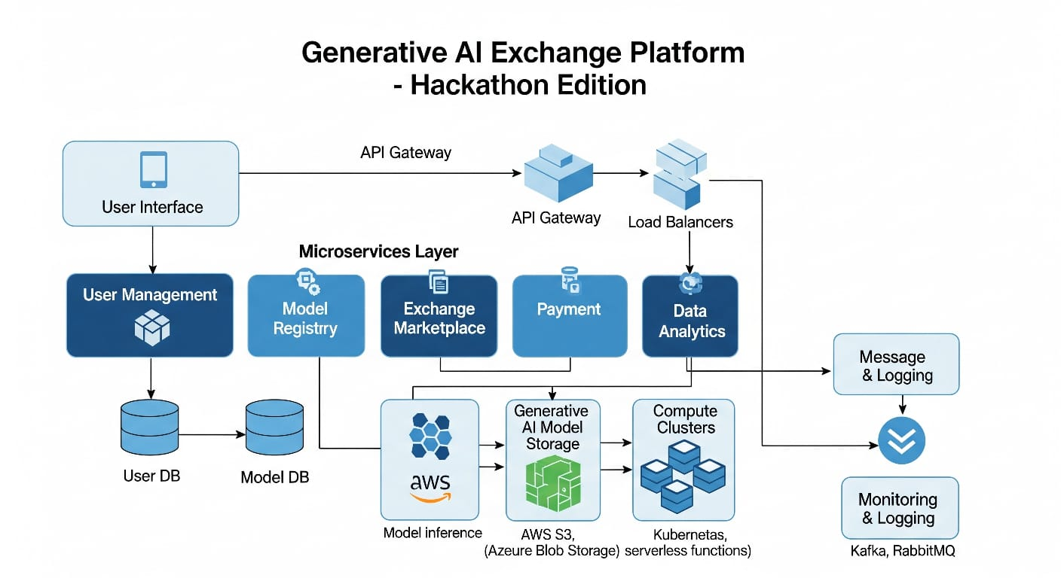
Architecture Diagram Of the Proposed Solution :

Slide 8
Technologies to be Used:
1. Core AI / ML Stack
Large Language Models (LLMs): OpenAI GPT, LLaMA, Falcon, or fine-tuned models.
RAG (Retrieval Augmented Generation): For domain-specific knowledge.
Embeddings & Vector Databases: Pinecone, FAISS, Weaviate.
2. Development Frameworks
LangChain / LlamaIndex: For chaining prompts and building workflows.
Hugging Face Transformers: Pre-trained models & fine-tuning.
PyTorch / TensorFlow: For custom ML model development.
3. Application Layer
Backend: FastAPI, Flask, Node.js.
Frontend: React.js, Streamlit, or simple dashboards.
Chat UI: Gradio, Streamlit, or custom web interface.
4. Infrastructure & Deployment
Cloud Platforms: AWS, GCP, Azure (for GPU/compute).
Model Hosting: Hugging Face Spaces, Replicate, or custom API.
Containerization: Docker + Kubernetes (if scaling needed).
5. Supporting Tools
Databases: PostgreSQL / MongoDB.
Visualization: Plotly, Power BI, Tableau.
Collaboration: GitHub, Notion, Slack.

Slide 9
Estimated Implementation Cost :
1. Core AI & ML
Pre-trained LLM API usage (e.g., OpenAI / Anthropic): $50–150 / month (depending on API calls).
Open-source LLM (e.g., LLaMA, Falcon) + fine-tuning: $200–500 (GPU credits).
2. Infrastructure
Cloud compute (AWS/GCP/Azure – basic GPU/CPU): $100–200 / month.
Storage (vector DB + app data): $20–50 / month.
3. Development Tools
LangChain, Hugging Face, Streamlit: Free / Open-source.
GitHub, collaboration, CI/CD: $10–20 / month.
4. Deployment
Hosting (Hugging Face Spaces / Replicate / Cloud VM): $30–70 / month.
Domain & SSL: $10–15 / year.

Slide 10
Add as Per the Requirements For the Hackthon :
Prototype (Hackathon Stage)
AI/ML APIs & Tools → Free (credits/open-source)
Hosting (basic) → $0–50 Total: Near Zero
Pilot (Post-Hackathon)
API Usage → $50–150 / month
Cloud + Storage → $100–200 / month
Deployment → $30–70 / month Total: ~$200–400 / month
Scaling (Full Implementation)
Enterprise Cloud + GPUs → $500–1000 / month
Advanced APIs/Databases → $300–500 / month
Maintenance → $100–200 / month Total: ~$1000–1500 / month
Visual Tip for Slide → Use a 3-level pyramid or stacked bar with:
Top: Prototype (~$0)
Middle: Pilot ($200–400)
Base: Scaling ($1000–1500)

Slide 11
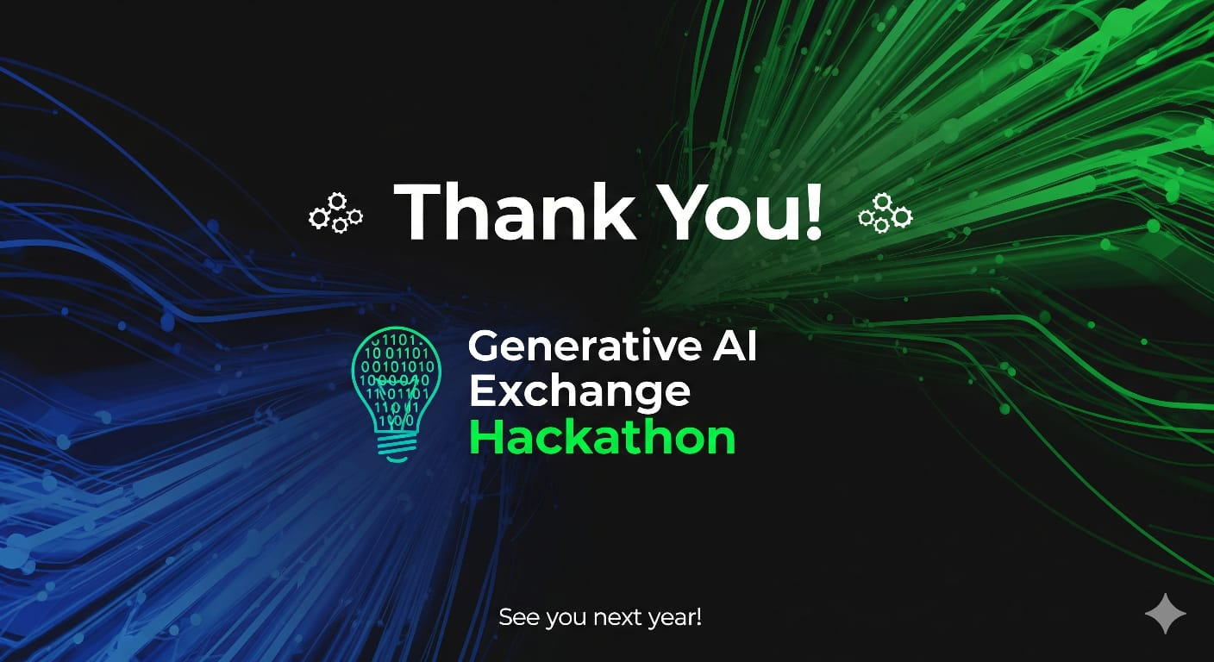
Google Cloud
i iżs
Thank you

